Slide 1

AZURE SECURITY

Slide 2
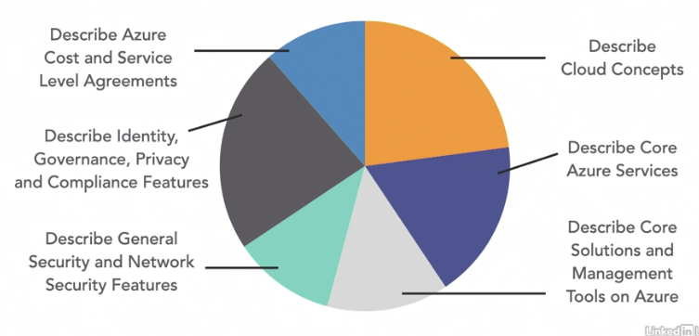
AZ-900: Azure Fundamentals Overview

Slide 3

Module 04 - Outline
You will learn the following concepts:
Azure Security features
Azure Security Center, including policy compliance, security alerts, secure score, and resource hygiene
azure Sentinel
Key Vault and Dedicated Hosts
Azure Network Security
Defense in depth
Network Security Groups and Firewalls
DoS protection

Slide 4
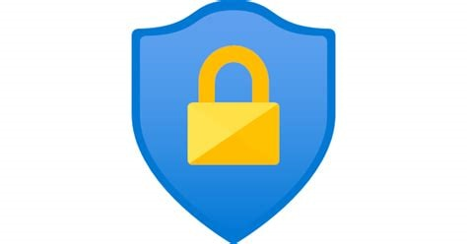
Azure Security Center
Azure Security Center is a monitoring service that provides threat protection across both Azure and on-premises datacenters.
Provides security recommendations
Detect and block malware
Analyze and identify potential attacks
Just-in-time access control for ports

Slide 5
Azure Security Center - Capabilities
Policy Compliance
Run policies across management groups, subscriptions, or tenants.
Continuous Assessments
Assess new and deployed resources to ensure that they are configure properly.
Tailored Recommendations
Recommendations based on existing workload with instructions on how to implement them.
Threat Protection
Analyze attempted threats through alertsand impacted resource reports.

Slide 6
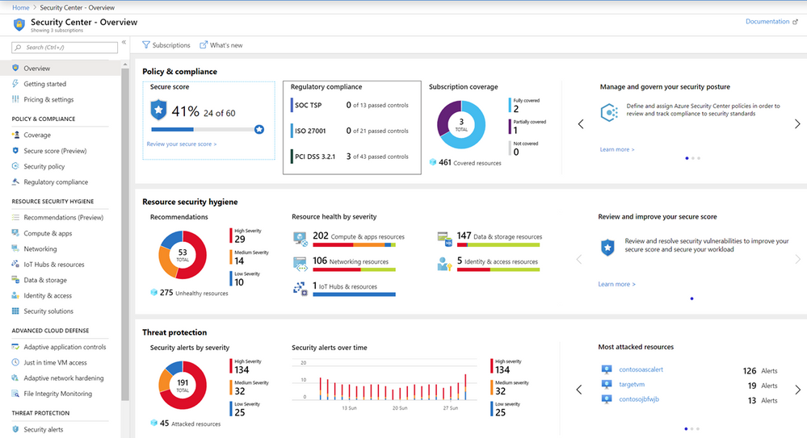
Azure Security Center Console

Slide 7
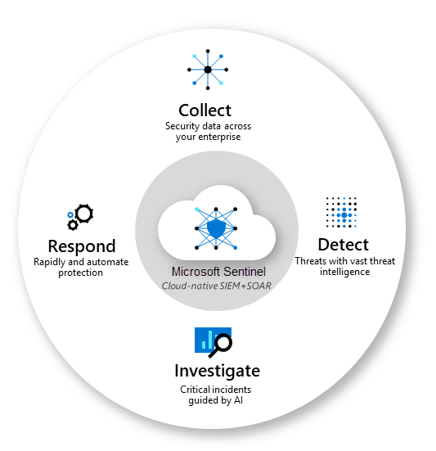
Azure Sentinel
Microsoft Sentinel is a scalable, cloud-native, security information and event management (SIEM) and security orchestration, automation, and response(SOAR) solution.
Microsoft Sentinel delivers intelligent security analytics and threat intelligence across the enterprise, providing a single solution for attack detection, threat visibility, proactive hunting, and threat response.

Slide 8

Azure Key Vault
Azure Key Vault stores application secrets in a centralized cloud location in order to securely control access permissions and access logging.
Secrets management.
Key management.
Certificate management.
Storing secrets backed by hardware security modules (HSMs).

Slide 9

Azure Dedicated Host
Azure Dedicated Host provides physical servers that host one or more Azure virtual machines that is dedicated to a single organization's workload.
Benefits
Hardware isolation at the server level
Control over maintenance event timing
Aligned with Azure Hybrid Use Benefits

Slide 10
Secure Network Connectivity - Objective Domain
Describe the concept and functionality of:
Defense in depth
Network Security Groups (NSG)
Azure Firewall
Azure DoS protection

Slide 11
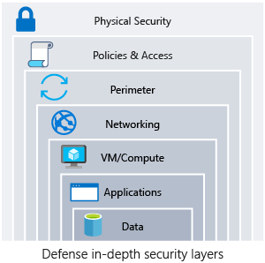
Defense in-depth
A layered approach to securing computer systems.
Provides multiple levels of protection.
Attacks against one layer are isolated from subsequent layers.

Slide 12
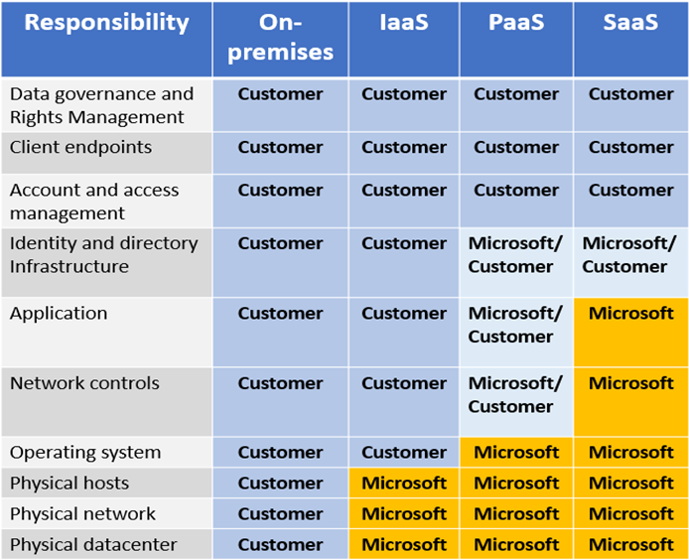
Shared Security
Migrating from customer-controlled to cloud-based datacenters shifts the responsibility for security.
Security becomes a shared concern between cloud providers and customers.

Slide 13
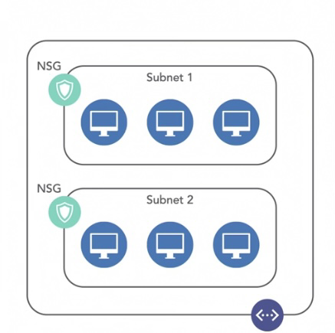
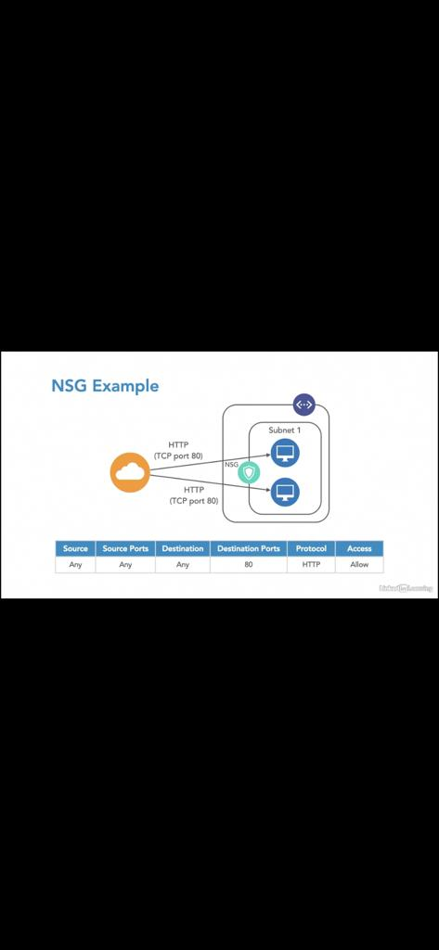
Network Security Groups (NSGs)
Network Security Groups (NSGs) filter network traffic to and from Azure resources onAzure Virtual Networks.
Set inbound and outbound rules to filter by source and destination IP address, port, and protocol.
Add multiple rules, as needed, within subscription limits.
Azure applies default, baseline security rules to new NSGs.
Override default rules with new, higher priority rules.

Slide 14
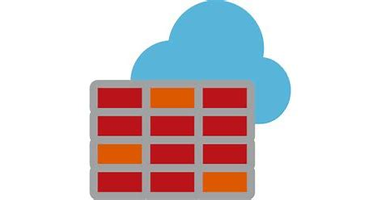
Azure Firewall
A stateful, managed Firewall as a Service (FaaS) that grants/denies server access based on originating IP address, in order to protect network resources.
Applies inbound and outbound traffic filtering rules
Built-in high availability
Unrestricted cloud scalability
Uses Azure Monitor logging
Azure Application Gateway also provides a firewall, Web Application Firewall (WAF). WAF provides centralized, inbound protection for your web applications.

Slide 15
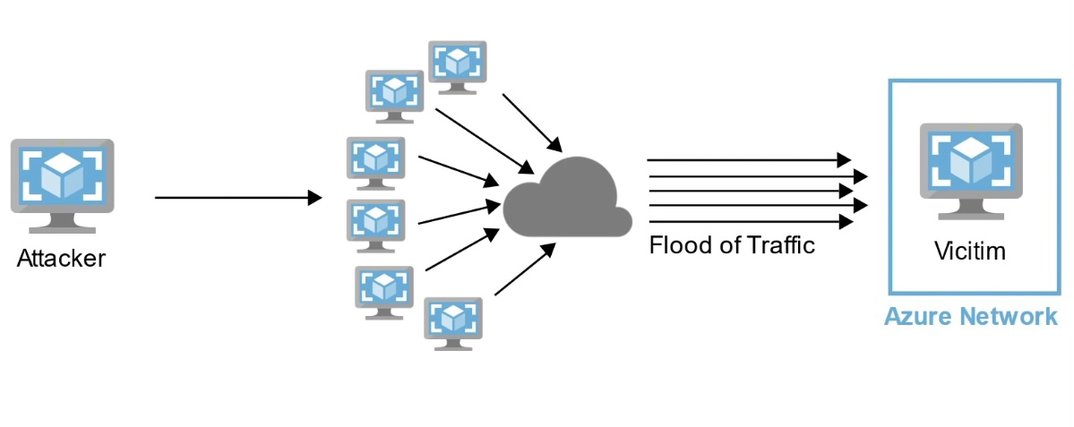
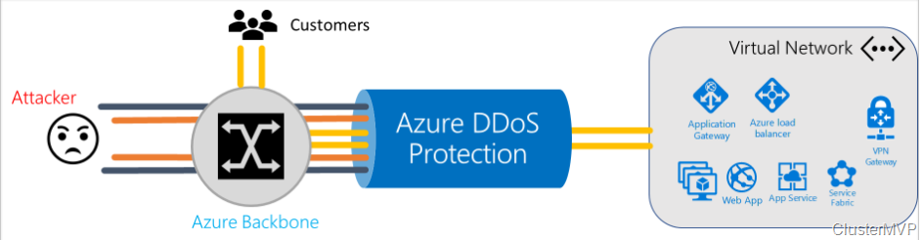
Azure DDoS Service Protection
A malicious attempt to disrupt normal traffic by flooding a website with large amounts of fake traffic.
DoS attacks overwhelm and exhaust network resources, making apps slower unresponsive.
Sanitizes unwanted network traffic before it impacts service availability.
Basic service tier is automatically enabled in Azure.
Standard service tier adds mitigation capabilities that are tuned to protect Azure Virtual Network resources

Slide 16
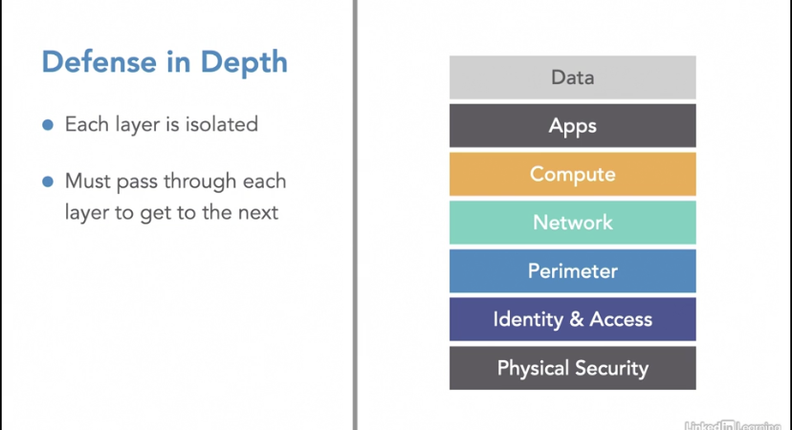
Defense in Depth Reviewed
Combining network security solutions
NSGs with Azure Firewall to achieve defense in depth.
Perimeter layer protects your network boundaries with Azure DoS Protection and Azure Firewall.
Networking layer only permits traffic to pass between networked resources with Network Security Group (NSG) inbound and outbound rules.

Slide 17
References:
One stop shop for all Azure Securityhttps:l/ww.microsoft.com/en-us/trustcenter/securitv#How-Microsoft-protects-your-dataNext

